Slide 1

INFO6205
GENETIC ALGORITHMS
TO SOLVE
LOCATION PROBLEM
IN FINANCIAL CENTER
Group Member:
Yuhuizi Rao, Ruoyu Xu

Slide 2
CONTENTS
01 . Explanation of topic
03 . Results
Problem background
Details of concepts
Core concepts
(1) Unit tests
(2) Output
02 . Implementation
04 . Conclusion
(1) Data genetation
(2) Solutions
(1) Graphs
(2) Conclusions

Slide 3
PART 01
Explanation of topic

Slide 4
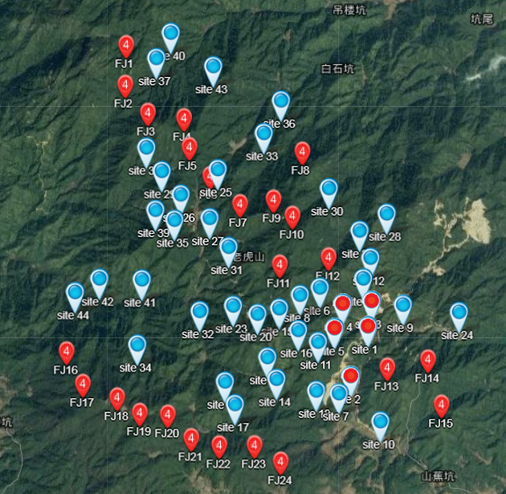

Explanation of topic
--PROBLEM BACKGROUND
SHOPPING CENTER SITE SELECTION
When select a location to construct a Shopping Center, we need to consider the surroundings building’s distance.
When the sum of these buildings to site is less, the possibility we choose it is more.
Besides, the amount of visitors flow, traffic signal number, and road condition also matter a lot.
Site selection planning is rationality related to the success or failure of development. Manual location planning is not only inefficient, but also has poor data accuracy.

Slide 5
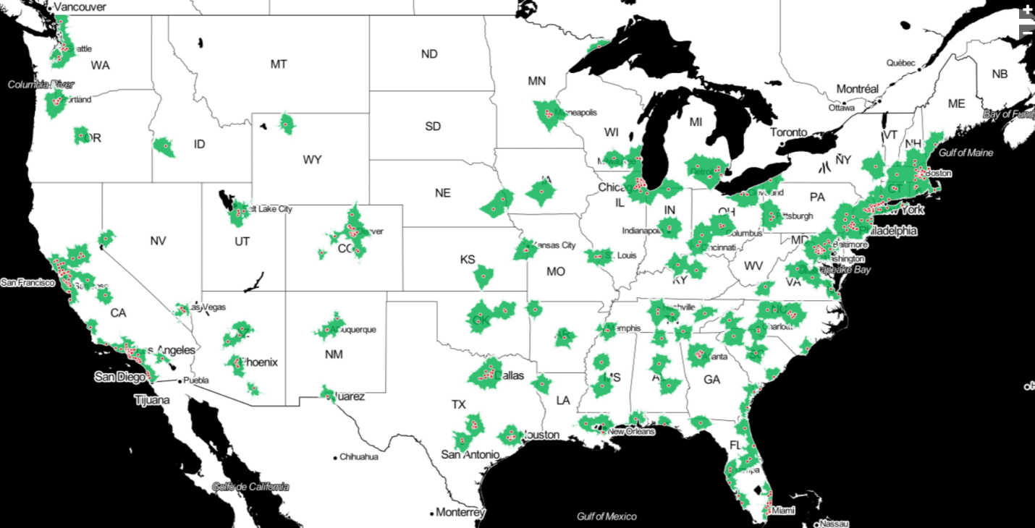
Explanation of topic
--PROBLEM BACKGROUND
The use of intelligent optimization algorithms instead of manual analysis for site selection not only reduces the cost of construction, but also helps to improve the efficiency and accuracy of planning and construction.
Aiming at this problem, the original algorithm is improved, and it is applied to the site selection planning for micro-experiment simulation, which improves the intelligence and accuracy of site selection.

Slide 6
Explanation of topic
--DETAILS OF CONCEPTS
First, we need to calculate the sum of geometric distance from base station to ten known users, formulate as follow:
标题文字添加
Where D denote sum of distance, x and y denote the coordinate of one of the 10
known office buildings.

Slide 7
Explanation of topic
--DETAILS OF CONCEPTS
Relation between degree of infeasibility and the total distance of
wire is quadratic:
S(D) = C3 +c2*D +(D-c1)*(D-c1)
C1 is the rate of visitors flow.
C2 is the road condition.
C3 is the number of traffic lights.
标题文字添加
Where S denote degree of infeasibility, D denote distance from base station to users, C denote constant.

Slide 8
Explanation of topic
--CORES OF CONCEPTS
1 1 0 1 0 0 1 1 1 0 0 0 1 0 1 1 0 1 0 1
Genotype: Since the whole program is based on the coordinate of 1024*1024, the format of the genotype will be presented as binary numbers with 10 + 10 bits. We can separate this genotype into two parts, the first 10 digital will be the Y-axis, and the last 10 digital will be the X-axis.
Expression: The expression will be presented in a three-dimensional coordinate system. The X-axis is the last 10 digital of the genotype of the certain point, the Y-axis is the first 10 digital of the genotype of the point, the Z-axis is the feasibility of the point.

Slide 9
Explanation of topic
--CORES OF CONCEPTS
Phenotype: The score of infeasibility.
Problem: We are trying to find out the point which has the lowest infeasibility score regarding several factors such as cost efficiency On the basis of ten known points.
Fitness: In our model, we are looking for the point which has the minimum score of infeasibility. The relationship between infeasibility score and the sum of length is quadratic equation instead of liner equation. Thus, the lower infeasibility score, the better fitness it has and the point has higher chosen probability, which means this points should holds higher ratio in the random process.

Slide 10

Explanation of topic
--CORES OF CONCEPTS
We regard a point(X,Y) as an individual, and
basically encode every coordinates into a 8-digit
integer which first 4 digits represent value
of Y, and last 4 digits represent Y.
And we use an array to store the encipher
coordinates. Encoding formula is shown as
below:
Point(X,Y) —>integer
integer=Y*10000+X
Example:
P(345,500)->int A=500*10000+345 =5000345

Slide 11
Explanation of topic
--CORES OF CONCEPTS
DECODING:
When we need to use a coordinate of a points, we have to
decode the number into two parts, which higher 4 digits and lower 4 digits
should be separated as following:
Integer—>Points(X, Y)
X = integer%10000 (Integer Modulo Operation)
Y = integer/10000 (Integer Division Operation)
Example: A = 5000345 -> P(X, Y)
X = 5000345%10000=345
Y = 5000345/10000=500

Slide 12
PART 02
IMPLEMENTATION

Slide 13
IMPLEMENTATION
--Initialization
From the map of 1024*1024 grid, we randomly select 10 office buildings as 10 points from the coordinates as our known invariant points. The problem will be to find out the point which has the minimum sum of distances from itself to these 10 offices buildings.
Then generate 1000 integer randomly initial group sample. Every integer includes the coordinate information of a point.

Slide 14
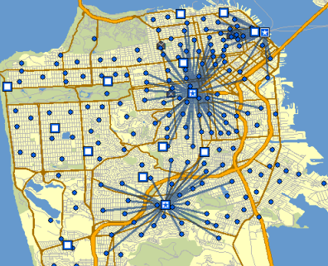
IMPLEMENTATION
--Selection method
Calculate S(D) of each selected 1000 point,
according to the weight computing method before.
S(D) = C3 +c2*D +(D-c1)*(D-c1)
C1 is a random integer in range [0,1023]
C2 is a fixed number 1000
C3 is a fixed constant 86
S(D) = 86 +1000*D +(D-c1)*(D-c1)
2. Get the ratio1,ratio2,ratio3,…, ratio1000 of
every point, the countdown of their ratio to
the sum.

Slide 15
IMPLEMENTATION
--Selection method
3. Look up each ratio, and sum all the ratio before it, which is named as accumulated ratio.
Accumulated ratio
2.10
1.67
0.51
ratio
0.32
0.19
1.16
0.43

Slide 16
IMPLEMENTATION
--Selection method
4. Generate a random double prob, compare it with each accumulated ratio. When
prob>accumulated Ratio[i], move it to the next until prob < accumulatedRatio[i].
Then take out the points in group, put it in the result group.
Accumulated ratio
2.10
accuRatio[1] =1.67
accuRatio[0] =0.51
ratio
0.32
0.19
1.16
0.43
Prob = 1.63
prob< 1.67, select point[1]

Slide 17
IMPLEMENTATION
1. Shuffle the 1000 points, then choose I and i+1 as a pair.
--Crossover
1. Pick pairs of points in group
2. The first 10th represent X-axis, The second 10th represent Y-axis.
2. Encode coorditae to 20 bits.
3. Get a random value 1 or 0. when it’s 0, change X-axis, it’s 1, change Y-axis.
3. Decide to change X-axis or Y-axis
4. Choose 2 bit to exchange.
4. Randomly choose 2 locations from 1-10 , Exchange i and i+1 at that bit.

Slide 18
IMPLEMENTATION
--Crossover
9 8 7 6 5 4 3 2 1 0
Choose 2 location 2,5
Cross Exchange value in 2,5 bit:
Point1[2]=point1[5]
Point1[5]=point1[2]
Point2[2]=point2[5]
Point2[5]=point2[2]
How to change value in particular location:
% get the bits after location
/ * get the bits before location
^ get the bit in that location
Combine them together
1 0 0 0 0 0 1 1 0 1
0 1 1 0 0 0 1 1 1 0
1 0 0 0 1 0 0 0 0 1
0 1 1 0 1 0 0 0 1 0

Slide 19
IMPLEMENTATION
--Mutation
Step1
Step2
Step3
First, select the position to mutate from 20 bits recorded as temloc. This process also randomly decide either X-axis or Y-axis to exchange.
Then let the gene mutation rate be 2% by selecting 1 from 50 integer. When mutation happening, if the value on tmploc equals 0, then change this bit into 1, else if the value equals 1 change it into 0.
The third step is to change the gene mutation rate from 2% to 10%. Record all test number and draw a graph to make a conclusion.

Slide 20
PART 03
RESULTS

Slide 21
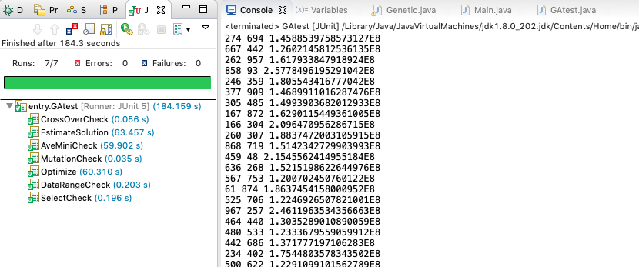
RESULT
--Unit tests

Slide 22
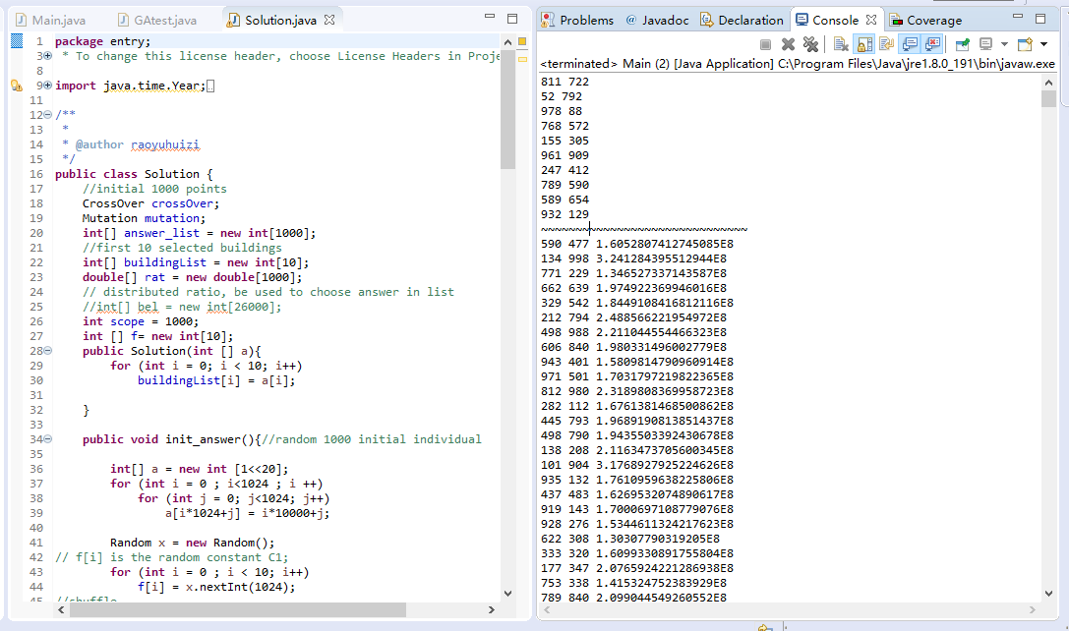
RESULT
--Output

Slide 23
PART 04
CONCLUSIONS

Slide 24
CONCLUSION
--Graphs
S(average) based on the different mutation ratio

Slide 25
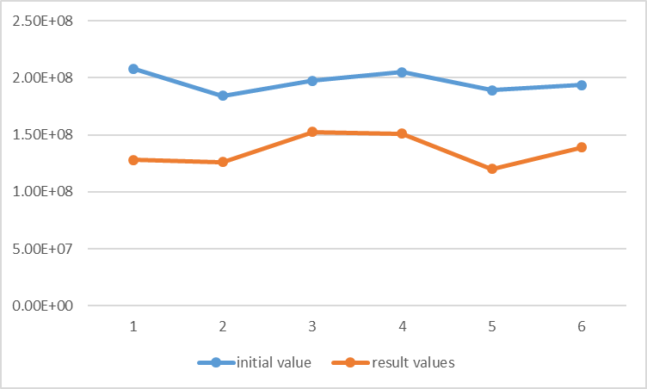
CONCLUSION
--Graphs
As can be seen from the graph, the results after our calculate is much smaller than the initial one, which means the total distance between different office buildings and the shopping mall is closer.

Slide 26
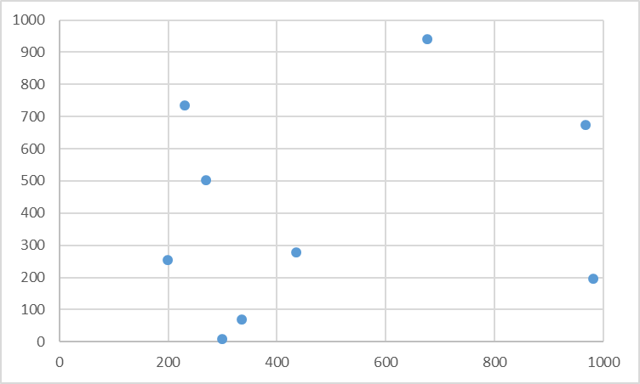
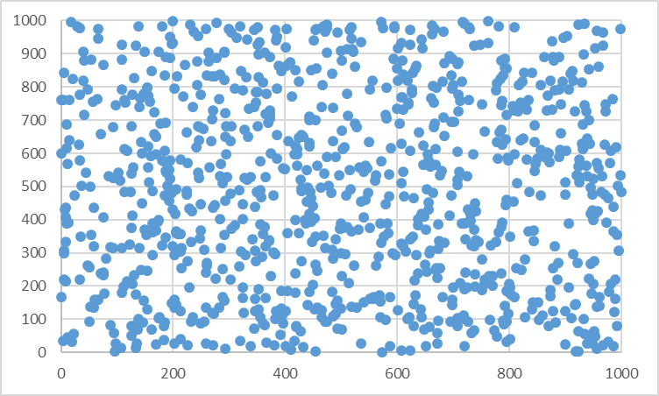
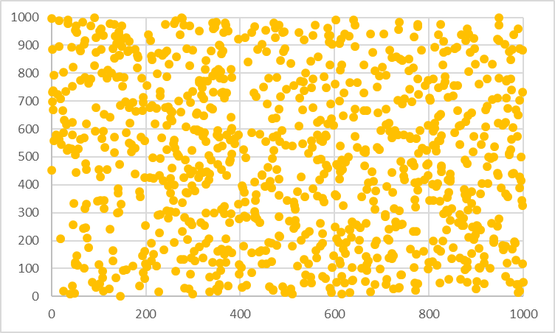
CONCLUSION
--Graphs
Office buildings
Initial points
result points

Slide 27
INFO6205
2019 Spring
Thank you for watching.

